Slide 1
ENEL 684
Identification for Control
Arne Dankers
03-09-2024

Slide 2
Numbers that describe themselves
14233221
6210001000

Slide 3
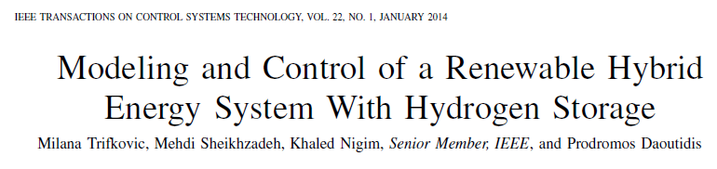
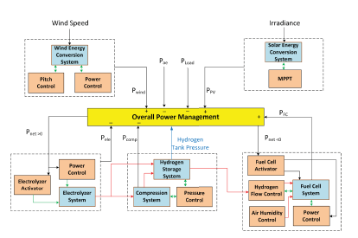
Running Example Throughout Class

Slide 4
What is a Dynamical System?

